Slide 1

IABP
DR DIVYA E M
SENIOR RESIDENT CARDIOLOGY

Slide 2
The intra-aortic balloon pump (IABP) is a temporary coronary and systemic perfusion assist device
Since introduction into clinical practice in the 1960s it has become widely used in critically ill patients with coronary disease and cardiac pump failure

Slide 3
AIM
Basic principle
Physiological effects
Appropriate set-up
Indications
Potential complications of the IABP
Notes:
Essential for improving patient outcomes

Slide 4
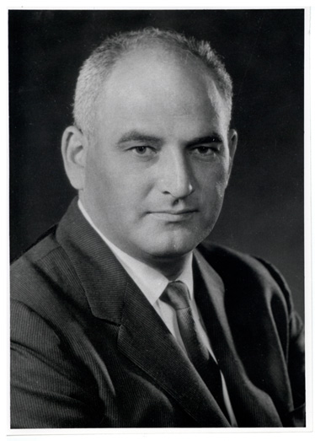
HISTORY
Kantrowitz described augmentation of coronary blood flow by retardation of the arterial pressure pulse in animal models in 1952
In 1958 Harken suggested removal of some blood volume via femoral artery during systole and replacing it rapidly in diastole as a treatment for left ventricular (LV) failure- so called diastolic augmentation

Slide 5
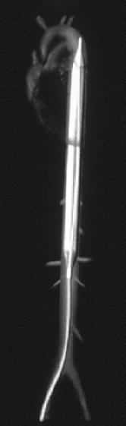
HISTORY
In 1960s Moulopoulos and colleagues from the Cleveland Clinic developed experimental prototype of IABP whose inflation and deflation were timed to the cardiac cycle
In 1968 Kantrowitz reported improved systemic arterial pressure and urine output with the use of an IABP in two subjects with cardiogenic shock one of who survived to hospital discharge

Slide 6
HISTORY
Balloon catheters were 15 French and needed to be surgically grafted into the femoral arteries.
Percutaneous IABs in sizes 8.5-9.5 French were introduced in 1979
Shortly after this Bergman and colleagues described the first percutaneous insertion of IABP
The first prefolded IAB was developed in 1986

Slide 7
Synchronized counterpulsation is the core principle of IABP therapy
Inflation in diastole and deflation in systole of a balloon situated in the descending aorta
Overall aim -to improve myocardial function by increasing myocardial oxygen supply and decreasing myocardial oxygen demand
Achieved by displacement of blood in the aorta both proximally and distally during balloon inflation

Slide 8
Cardiac Physiology
The Cardiac Cycle
Contraction of the ventricles propels blood into the systemic or pulmonary circulation
This coordinated succession of cardiac events must be understood in order to grasp the concept of interaction of IABP with cardiac physiology

Slide 9
The cardiac cycle is divided into two major phases:
  Diastole and systole
They are further subdivided into different mechanical periods
The subdivisions addressed will be those that directly relate to physiology as applied to IABP therapy

Slide 10
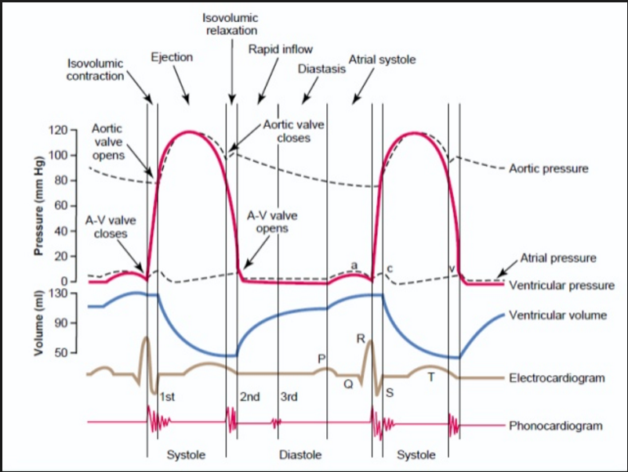
Anatomy and Physiology as Related to Counterpulsation Therapy

Slide 11
Diastolic Events
Isovolumetric Relaxation
The onset of diastole brings relaxation of the myocardium
The pressures in the ventricles fall below that in aorta and pulmonary artery
The higher pressure causes the semilunar valves to close
Seen on arterial pressure waveform as the dicrotic notch- generally accepted as the beginning of diastole
The high pressures in the ventricles prevent the opening of the mitral and tricuspid valves
Hence for a short time there are no volume changes within the ventricles
Notes:
During IVR the semilunar valves are closed

Slide 12
Ventricular Filling
Mitral and tricuspid valves open when the ventricular pressures fall below atrial pressures
The ventricles continue to relax which causes a further drop in pressure and an increasing gradient of pressure from atria to ventricles
The increasing gradient causes rapid inflow of blood to the ventricles
Notes:
The ventricles then fill rapidly with the blood that has accumulated in the atria

Slide 13
With continued ventricular filling atrial pressures fall
Ventricular pressures rise thereby reducing the pressure gradient
As the gradient is reduced the ventricular filling rate decreases

Slide 14
Atrial Contraction
Relatively late in the diastolic phase
Atria undergo depolarization
Atria contract and force the remaining contents into the ventricles
The contribution to total ventricular volume from atrial contraction varies between 15-25%
This variance is influenced greatly by the venous return and the heart rate
Notes:
At the end of this period, the ventricles depolarize. Diastole ends with the onset of ventricular
contraction

Slide 15
Systolic Events
Isovolumetric Contraction
Both the atrio-ventricular valves and the semilunar valves are all closed
Aim is to build enough pressure to achieve ejection of ventricular contents
This period of pressure building utilizes much energy
Approximately 90% of myocardial oxygen consumption occurs during the IVC phase
Notes:
At onset of systole the pressure in the atria and ventricles are approximately the same
With the onset of contraction the pressure in the ventricles rises higher than the pressure in the atria causing closure of the mitral and tricuspid valves
There are no volume changes taking place at this time until the ventricles generate a pressure greater than the pressures in the aorta and pulmonary artery
The aortic and pulmonic valves remain closed until the ventricles generate a pressure higher than the pressures in the aorta and pulmonary artery
The IVC period corresponds to the ascending limb on the ventricular curve of Figure 2.
The length of the IVC phase is determined by the speed of contraction and the pressure generation necessary (aortic or pulmonic end diastolic pressure) to open the semilunar valves

Slide 16
Rapid Ventricular Ejection
Aortic and pulmonic valve opening signifies the onset of the rapid ejection and the end of IVC
The aortic valve opens when the left ventricular pressure exceeds the aortic end diastolic pressure (AEDP)
The LV and aorta become one chamber with pressure rising very rapidly
Approximately 65-75% of stroke volume is ejected during this period
Notes:
The rapid ejection phase is seen on the ascending limb of the arterial pressure waveform
Rapid ventricular ejection continues until the point of maximum ventricular pressure
This point is called peak systolic pressure

Slide 17
Reduced Ventricular Ejection-start of relaxation
Pressure in the ventricles begins to decrease after the peak systolic pressure
Ventricles are not contracting as forcefully
But blood continues to flow because of the momentum of forward flow
The remaining 25-35% of stroke volume is ejected during this phase of systole
Notes:
The reduced ejection period is seen on the descending limb of the arterial pressure waveform
Systole ends with the onset of myocardial relaxation and the cycle repeats itself
(Closure of the aortic valve.)

Slide 18
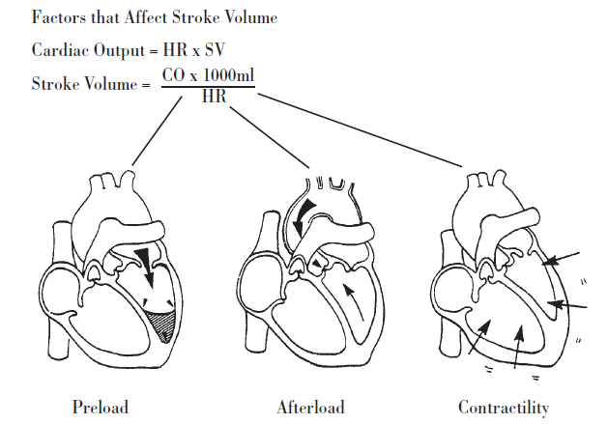
Determinants of Cardiac Output
The CO is expressed in liters per minute-normal: 4-8 L/min
CO= SV X HR
Notes:
The heart functions as a mechanical pump within a dynamic vascular system.
The performance of the heart is typically expressed in terms of cardiac output (CO)
The HR is controlled by the rate set point of the sinus node
and influenced by the central nervous system, endocrine system, and the pressure and stretch
receptors located in the central vascular system. If SV is insufficient, the HR must increase to
maintain CO.

Slide 19
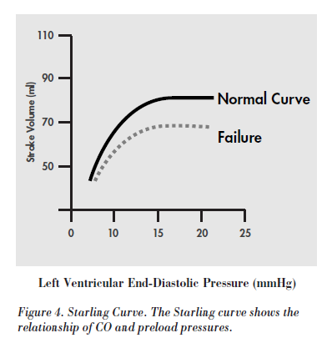
Preload
The amount of stretch on the ventricular myocardium prior to contraction
Frank and Starling ‘s Law
  An increase of volume in ventricle at the end of diastole resulted in increase in the volume of blood pumped
Notes:
Frank/Starling law
The greater the muscle fibers are stretched during diastole, the stronger the next contraction, up to a certain point. The fibers can only stretch to a certain
point before they lose their resilience and elasticity, resulting in decreased CO.The left ventricular end diastolic pressure (LVEDP) is used as an indication of ventricularr volume. Preload has also been termed “filling pressure” and is clinically measured by the pulmonary capillary wedge pressure
The most important concept to keep in mind regarding Starling’s law of the heart is that there is an optimal preload pressure in each clinical situation
In a diseased heart necessitating IAB support, preload is usually increased to such a point that “over-stretching” of the ventricular chamber has occurred resulting in a decreased CO
The goal of the IAB in such a disease state is to decrease or “optimize” preload by ensuring a filling pressure high enough to obtain the highest CO on the Starling curve but not so high as to cause pulmonary congestion
In addition preload is a component of MVO2, so as PCWP increases, MVO2 increases

Slide 20
Afterload
Afterload is the impedance to ventricular ejection
Impedance are
  Hct-the mass of blood that must be movedt
  Aortic end diastolic pressure
  The resistance of the arterioles
As the afterload increases the speed of ejection slows and the SV falls
Notes:
The hematocrit has a large influence on the mass of blood. The higher the mass the more inertia that needs to be generated to achieve blood movement
If the AEDP is 80mm Hg, then the left ventricle must generate 81mm Hg to open the aortic valve to achieve some forward blood flow

Slide 21
Contractility
Intrinsic ability to contract independently of the effects of preload or afterload
An increase in contractility will increase force of contraction, stroke volume, MVO2 and delivered O2 to the ventricles
Therefore generally the myocardial supply/demand ratio improves
Notes:
Preload/Afterload may increase/decrease contractility
An indication of contractility is the ejection fraction
The normal EF is 65-75%

Slide 22
Physiology of coronary circulation
Coronary blood flow dependent on diastolic pressure
The right side of the heart is better perfused during systole compared to the left side
The coronary vascular bed is auto regulated balancing myocardial oxygen supply and demand
Coronary vascular resistance is influenced by neural, metabolic and haemodynamic factors
Notes:
due to compression of coronary blood vessels within myocardium during systole
Left heart pressures are much higher than the right side
The coronary arteries - innervated by sympathetic and parasympathetic nervous systems
Alpha receptor -vasoconstriction
beta-2 receptor and the vagus nerve - vasodilatation
Regional perfusion is regulated by metabolic factors
Mediators like carbon dioxide,adenosine, hydrogen ions, phosphate, prostaglandins and potassium cause vasodilatation

Slide 23
Below 60 mmHg coronary perfusion –
  auto regulation is lost
  the coronary vessels become maximally dilated
  blood flow depends only on perfusion pressure
Haemodynamic factors that affect coronary perfusion
  arterial pressure (diastolic pressure)
  diastolic time
  intra-ventricular pressure

Slide 24
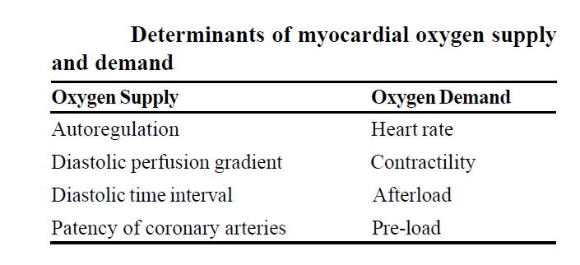
Myocardial Oxygen Balance

Slide 25
Supply
Ninety percent of coronary artery perfusion takes place during the diastole
Hence diastolic pressure is the driving force for coronary artery filling
Normal coronary perfusion pressure (CPP) is approximately 65mm Hg
The length of diastolic time is determined by the heart rate
Increased HR allows less time for coronary artery filling
Normally myocardium extracts 60-75% of its oxygen from the blood
Notes:
but in severely diseased states, coronary blood flow can become tremendously impaired necessitating higher perfusion pressures to supply the same amount of blood flow.
It is difficult to extract more oxygen than this, but the myocardium can increase its oxygen consumption several-fold during periods of stress
How then, if most of the oxygen is extracted from arterial blood, can the myocardium increase the amount of delivered oxygen to meet the metabolic needs? Oxygen delivery is improved by increasing blood flow through the coronary arteries by a process called autoregulation. The limiting factor of increased oxygen delivery in diseased hearts is the inability to dilate coronary arteries further to meet the demands of increased flow and supply. It is important to distinguish between oxygen demand, oxygen supply and oxygen consumption. The consumption cannot increase to meet demand if supply of oxygen is insufficient.

Slide 26
Demand
The variables that increase oxygen demands are several:
Heart Rate
LV wall tension
Contractility

Slide 27
The Law of Laplace
Describes the interaction of preload and afterload and their affects on myocardial oxygen consumption (MV02)
To calculate the tension or stress in the myocardial wall during the IVC phase of systole
T=Pr/2h
    T = myocardial wall tension
    P = intraventricular pressure
    r = intraventricular radius
    h = ventricular wall thickness

Slide 28
An increase in the pressure generated by the ventricle will increase the wall tension-afterload
A rise in LVEDV or LVEDP will increase the wall tension- preload
Ventricular wall tension is inversely proportional to the wall thickness
  Thinning of the ventricular wall will increase wall tension

Slide 29
Heart Rate
Increased heart rate will increase MVO2 as each contraction utilizes oxygen
The increase in oxygen consumption can be serious especially in the patient unable to maintain CO by increases in SV
An already compromised myocardium cannot sustain an increase in HR without some liability

Slide 30
Contractility
Increase in contractility increases MVO2
Compounds the oxygen demands further by increasing the pressure generation of the ventricle

Slide 31
Principles of IABC
In original model
  Blood removed and reinjected into aorta in a manner counter to the cardiac cycle hence the term counterpulsation
It adds volume to the aorta during diastole to increase diastolic blood pressure
  Goal - to improve perfusion pressure to the coronary and systemic circulation
As perfusion pressure increases oxygen availability to the coronary and systemic circulation increases

Slide 32
Aortic pressure is reduced just before systole by removing volume from the aorta
Reduces the resistance or afterload for the next left ventricular ejection
Hence the heart can eject a greater stroke volume at a lower work level
Effectively reducing myocardial oxygen demand
Also reduces preload and improve myocardial efficiency

Slide 33
Principles of Intra-Aortic Balloon Counterpulsation
General Concepts
  Placement
  A flexible catheter with a balloon mounted on the end is inserted in the femoral artery and passed into the descending thoracic aorta
  The balloon is situated 1 – 2cm below the origin of the left subclavian artery and above the renal artery branches
  On daily CXR the tip should be visible between the 2nd and 3rd intercostal space

Slide 34
Too low
    origin of the renal arteries may be obstructed compromising renal perfusion
Too high
    obstruction of the origin of the left subclavian or the left carotid artery could result
The intra-aortic balloon should not totally occlude the aortic lumen during inflation
    Ideally it should be 85-90% occlusive
Total occlusion could result in aortic wall trauma and damage to red blood cells and platelets
Notes:
This placement is critical for proper operation and avoidance of arterial tributary obstruction.

Slide 35
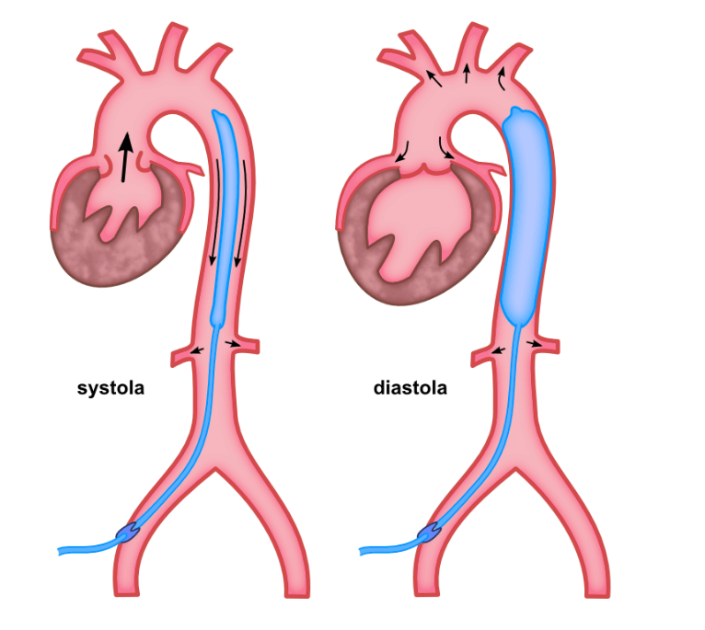
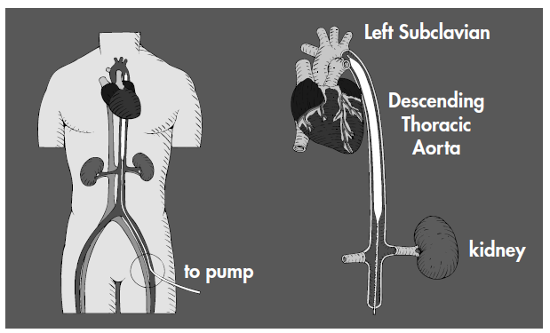

Slide 36
Volume Displacement
Synchronized counterpulsation is the core principle of IABP therapy
IABP exerts its effect by volume displacement and pressure changes
    caused by rapidly shuttling helium gas in and out of the balloon chamber
At precisely timed interval the gas enters the balloon chamber within aorta
As gas is shuttled into balloon it occupies a space within aorta equal to its volume
The usual adult balloon volume is 40cc (30-50cc)
Sudden inflation causes blood to be moved superiorly and inferiorly
Notes:
Since the volume in the aorta is suddenly increased, and the aortic wall is fairly rigid, the intra-aortic pressure increases sharply
With deflation of the intra-aortic balloon, the chain of events is in the reverse. A sudden 40cc fall in aortic volume causes a sudden decrease in aortic pressure within that localized area. In response to the local fall in pressure, the blood in adjacent areas moves to normalize the pressure within the aortic cavity as a whole.
Displacement of blood volume (both away from the balloon on inflation and toward the balloon on deflation) is the mechanism by which the IABP alters the hemodynamic state
In order to obtain beneficial hemodynamic changes the inflation and deflation of the balloon must occur at optimum times in the cardiac cycle

Slide 37
Balloon Inflation: Hemodynamics
Inflation of balloon is set to occur at onset of diastole
At the beginning of diastole maximum aortic blood volume is available for displacement
If occurs later in diastole the pressure generation from volume displacement will be lower
In late diastole much of the blood has flowed out to the periphery and there is less blood volume in the aorta to displace

Slide 38
Benefits of Accurately Timed Inflation
Coronary artery blood flow and pressure are increased
  Increased perfusion may increase the oxygen delivered to the myocardium
Increased diastolic pressure also increases the perfusion to distal organs and tissues
  increased urine output cerebral perfusion
Coronary collateral circulation is potentially increased from the increased CPP
Systemic perfusion pressure is increased

Slide 39
Balloon Deflation: Hemodynamics
The balloon remains inflated throughout the diastolic phase
Deflation of the balloon should take place at the onset of systole during the IVC phase
The left ventricle has to generate a pressure greater than the AEDP to achieve ejection
The sudden evacuation of the 40cc volume will cause a fall in pressure in the aorta
Properly timed deflation will cause a fall in pressure therefore the left ventricle will not have to generate as much pressure to achieve ejection

Slide 40
The IVC phase is shortened thereby decreasing the oxygen demands of the myocardium
Since the left ventricle will be ejecting against a lower pressure the peak pressure generated during systole will be less

Slide 41
1 The pressure that the LV must generate is less throughout the systolic phase
    Afterload is reduced which decreases myocardial oxygen demands
IVC phase is shortened
    Decreases oxygen demands
3 Reduced afterload allows the LV to empty more effectively
    SV is increased
    In addition preload is reduced if elevated
4 Enhanced forward CO
  Decreases left to right shunt in cases of intraventricular septal defects
  Incompetent mitral valve

Slide 42
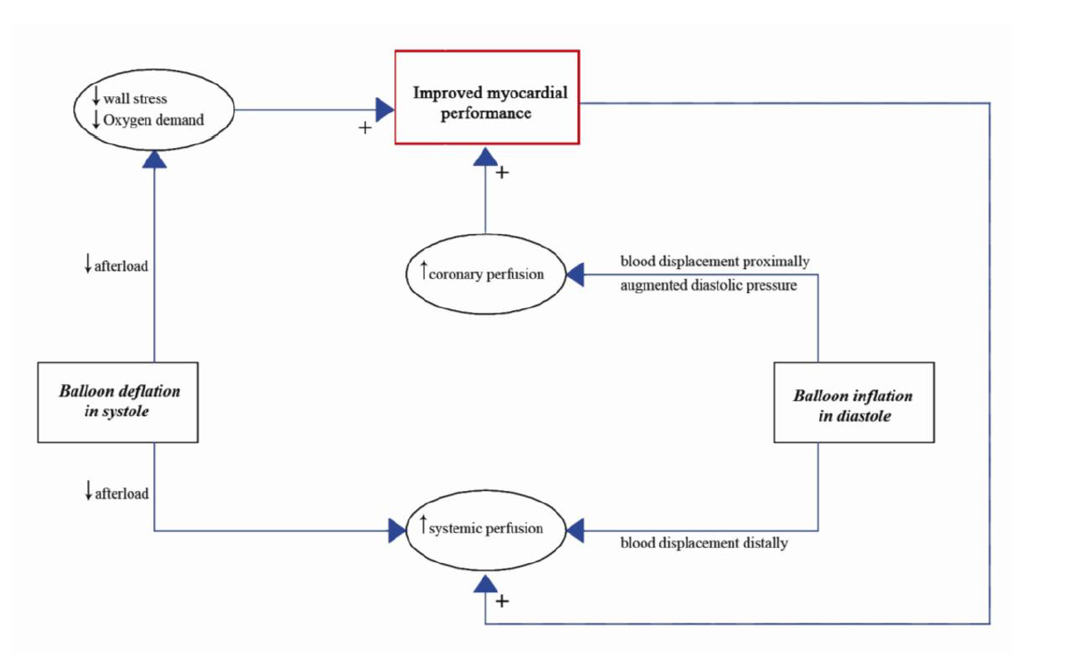
Physiological effects of IABP

Slide 43
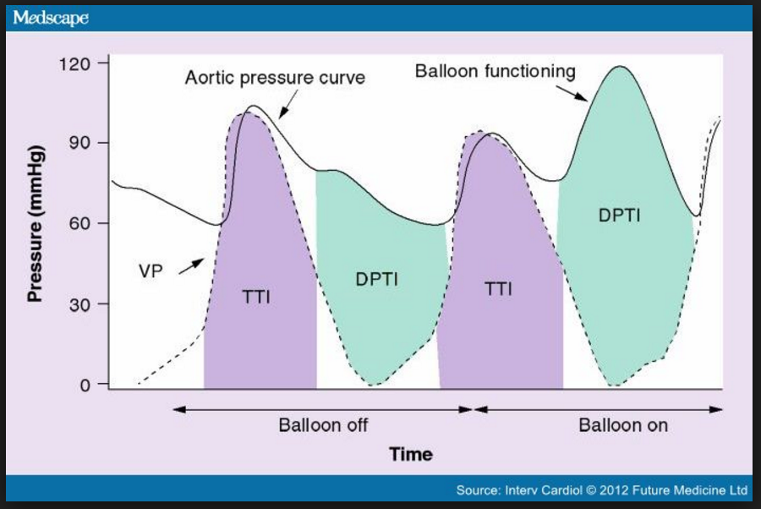

Slide 44
Clinical Correlates of IAB Pumping
What You Should See as Signs of an Improved Clinical Condition
The alteration of improved coronary circulation and decreased myocardial workload all affect the patient’s clinical status
Many reflect the benefits of both inflation and deflation
Some are primarily caused by one action or the other

Slide 45
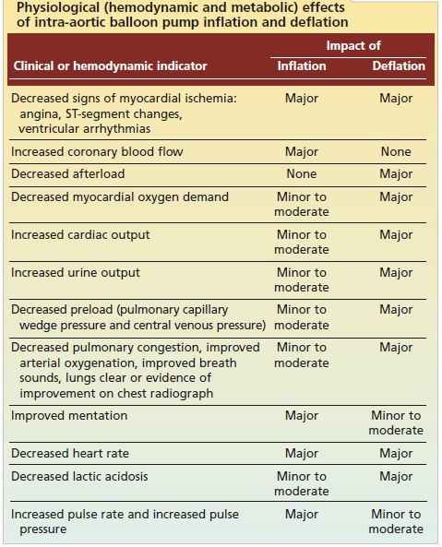

Slide 46
Indications
Indications with proven benefit
Cardiogenic shock secondary to AMI refractory to medical therapy
Mechanical complications of AMI: acute MR and VSR
Refractory ventricular arrhythmias
Refractory unstable angina
Decompensated systolic heart failure (as a bridge to definitive treatment)

Slide 47
Indications with probable benefit
Peri-operative support for high risk coronary artery bypass surgery
Peri-operative support for high risk cardiac patients undergoing non-cardiac surgery
Decompensated aortic stenosis

Slide 48
Indications with no evidence to suggest benefit
Sepsis
Routine use in high-risk patients undergoing PCI

Slide 49
Condition in which IABC would be most successful: Singh et al
1) Triple Vessel disease with moderately preserved left ventricular function and good distal targets
2) Significant mechanical lesions such as mitral insufficiency or ischaemic ventricular septal defect

Slide 50
WHAT MAJOR STUDIES SAY……..
IABP-SHOCK II TRIAL,NEJM-2012 Oct 4
In this large, randomized trial involving 600 patients with cardiogenic shock complicating acute myocardial infarction, for whom early revascularization was planned, intraaortic balloon pump support did not reduce 30-day mortality

Slide 51
BCIS-1 (Balloon pump-assisted Coronary Intervention Study )
A multicenter RCT that assigned 301 patients with severe ischemic cardiomyopathy to receive elective IABP before PCI or to undergo PCI without planned IABP support
No difference in the frequency of Major Adverse Cardiac and Cerebrovascular Events (MACCE) at hospital discharge (capped at 28 days)
Procedural complications occurred less often in the elective IABP group and 12% of patients assigned to have PCI without IABP support required rescue IABP insertion because of hemodynamic instability

Slide 52
Counterpulsation Reduces Infarct Size Pre-PCI (CRISP)
Third of the recent RCT addressing the use of IABP
Examined the role of the IABP in anterior ST-segment elevation-acute coronary syndrome without cardiogenic shock
Multicenter randomized trial, including 337 patients, who were randomized in a 1:1 ratio to either IABP before PCI or PCI alone
There was no difference in the infarct size assessed by cardiac MRI, the primary end point of the trial

Slide 53
CONTRAINDICATIONS
Absolute
Significant aortic regurgitation and aortic dissection
Aortic stent
End-stage cardiac disease with no viable other treatment options
Bilateral femoral-popliteal bypass grafts (femoral route only contraindicated)

Slide 54
Relative
Uncontrolled sepsis
Abdominal aortic aneurysm
Severe bilateral peripheral vascular disease
Uncontrolled bleeding disorder
Prosthetic ileo-femoral grafts/iliac artery stents
End-Stage Terminal Disease

Slide 55
COMPLICATIONS
The Benchmark Counterpulsation Outcomes Registry
Published data on nearly 1,700 patients who un-derwent IABP therapy between 1996 and 2005
2.8% of patients experienced one or more major complications
  (defined as death, major limb ischaemia, severe bleeding or balloon leak)
The incidence of minor complications was 4.2%.

Slide 56
Complications of the Intra-Aortic Balloon Pump
Aortic Wall
  Dissection
  Rupture
  Local Vascular Injury
Emboli
  Thrombus
  Plaque
  Air
IAB Rupture
  Helium Embolus
  Catheter Entrapment
Infection

Slide 57
Obstruction
Malposition
  . Too high - obstruction of left
  subclavian, carotids
  . Too low - obstruction of renal and
  mesenteric arteries
Compromised circulation due to catheter
  . Ischemia
  . Compartment Syndrome
Hematologic
  Bleeding
  Thrombocytopenia

Slide 58
The balloon pump device
The console
The IABP console delivers a specific volume of gas through a pneumatic system into a balloon during a predetermined time interval followed by retrieval of the gas
The console contains:
  A cylinder of gas source (usually helium)
  A valve unit which allows delivery of the gas
  A monitor system for acquisition of electrocardiogram and arterial blood pressure
  Control unit - processes the ECG and develops a trigger signal used for timing of balloon inflation and deflation
Notes:
by activating the valve unit and allowing either opening of the valve in order to deliver the gas or closure of the valve unit in order to stop the gas flow

Slide 59
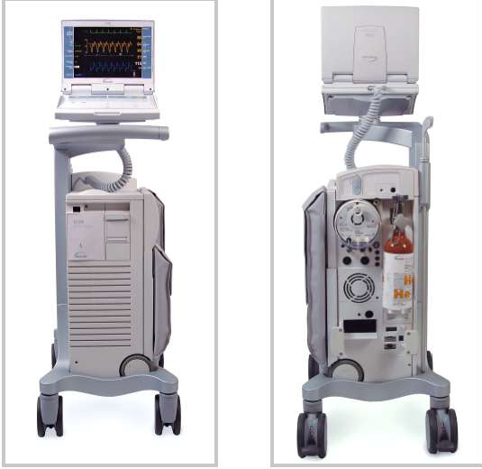
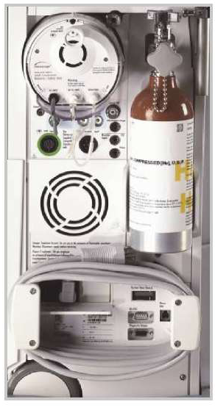

Slide 60
Balloon catheters
Balloon catheters are presented in a sterile insertion kit
Made of polyurethane
Manufactured in sizes varying from 8.5F to 10.5F
For children sizes are available between 4.5F to 7F
The adult catheters have a standard length of 32.5 inches
The volume of the balloon is 30-40 ml in adults and 2.5-25 ml in children

Slide 61
The driving gas
Both Helium and Carbon dioxide have been used
However helium has theoretical advantages
  Hendrickx et al
These include
  Lower density-rapid coefficient of diffusion
    The speed of gas entry and retrieval
  Maintenance of a larger volume of gas within the balloon for a longer period of time due to lower viscosity of helium as compared with CO2

Slide 62
IAB Catheter Insertion
Pre-Insertion Assessment
A complete pre-insertion assessment would include:
skin color of both legs
skin temperature of both legs
capillary refill ability of both legs
quality of pulses in both legs
baseline sensation and movement of both legs
ankle/brachial index of both legs
pre-insertion hemodynamics including CO, CI, PCWP, CVP, SVR, PA, LVSWI
complete neuro check
patient’s/family understanding of procedure
Ankle/Brachial Index
Notes:
Good assessment prior to insertion documents the need for therapy and provides a baseline for
evaluation of treatment efficacy. The circulation to both legs should be evaluated prior to
insertion, to determine the best side for insertion and to establish a baseline.

Slide 63

Balloon Sizing
Notes:
Should be chosen with respect to the patient size
For improved safety and effectiveness of balloon counterpulsation
Generally chosen by the patient’s height and possibly aortic diameter so that the balloon is positioned above the renal vasculature

Slide 64
Aortic size- related to patient size, age and weight
The ideal balloon
  Length from the left Subclavian artery to the coeliac artery take off
  Inflated diameter 90 to 95 % of that of the discending aorta
IABC usage has mainly been limited to ( in 82 %)
  40 cc balloon
  With membrane length (non tapered section plus tapered ends) varying between 22 to 27.5 cm
  Inflated diameter between 15 to 18 mm

Slide 65
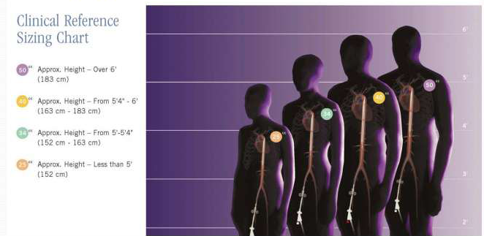
IABP sizing chart

Slide 66
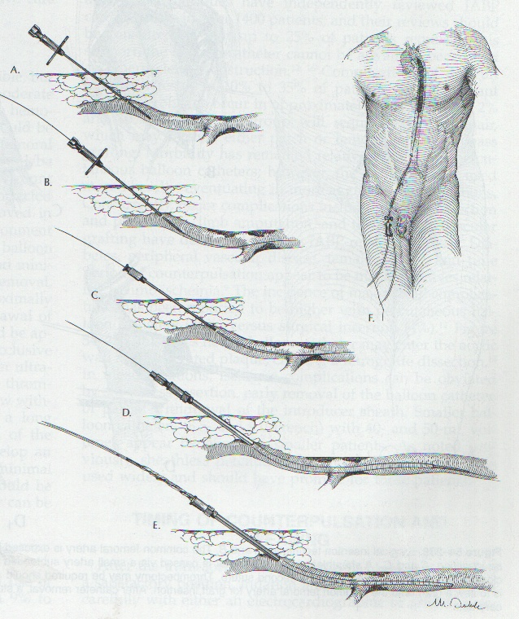
INSERTION TECHNIQUE
Percutaneous
  Sheath less
  With Sheath
Surgical insertion
  Femoral cut down
  Trans-thoracic

Slide 67
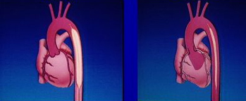
POSITIONING
The end of the balloon should be just distal to the left subclavian artery
Position should be confirmed by fluoroscopy or chest x-ray

Slide 68
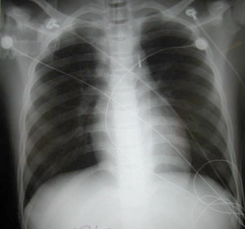
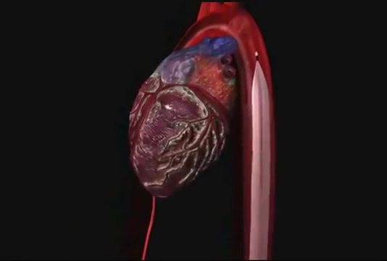
Positioning
Should be ~2 cm below the origin of left subclavian artery
3-4mm metalic density
2cm bellow the top of aortic knob
2nd – 3rd intercostal space anteriorly

Slide 69
HOW TO ADJUST IABP

Slide 70
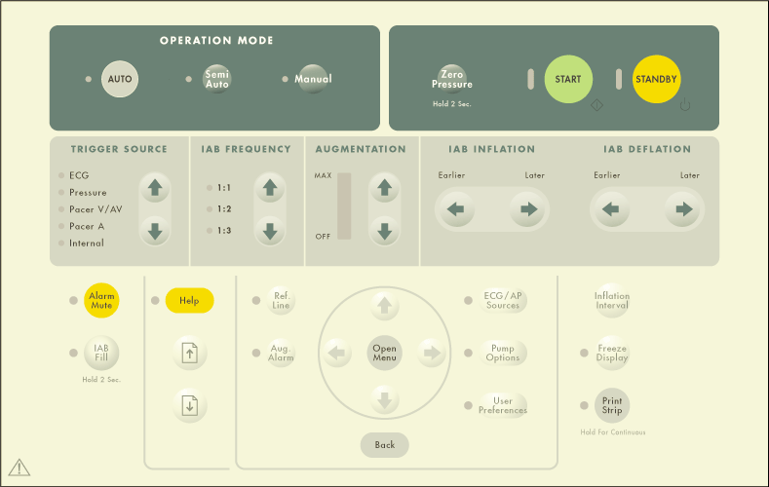
OPERATION MODE

Slide 71
OPERATION MODES
Automatic | Tracks cardiac cycle, cardiac rhythm and adjusts automatically
Semiautomatic | Operator must adjust inflation & deflation
Manual | Operator must adjust inflation & deflation & can set fixed rate

Slide 72
Trigger Modes
A reliable trigger needed to signal before balloon pumping can begin
The computer in console needs a stimulus to cycle the pneumatic system which inflates and deflates the balloon
The trigger signals computer that another cardiac cycle has begun
Mostly preferable to use the R wave of the ECG as the trigger
Back-up options - arterial pressure waveform and pacer spikes
If control of the trigger mode is desired select Operator mode

Slide 73
ECG Pattern
Analyzes the height, width and slope of a positively or negatively deflected QRS complex
The width of the R wave must be between 25-135msec
Trigger of choice when the rhythm is regular
HR is less than 130bpm and
QRS complex is normal width
Notes:
Widened QRS complexes may not be recognized, such as bundle branch blocks

Slide 74
ECG Peak
Analyzes the height and slope of a positively or negatively deflected QRS complex
Of choice when the rhythm is regular
And the QRS is wide
Or HR is greater than 130bpm
Also if the rhythm is irregular and ARRHYTHMIA TIMING is turned OFF

Slide 75
AFIB
Analyzes the QRS in the same manner as Peak mode
Balloon will automatically be deflated whenever an R wave is sensed
Of choice when a rhythm is irregular and ARRHYTHMIA TIMING is ON

Slide 76
AP
Arterial pressure mode uses the systolic upstroke of an arterial pressure waveform as the trigger signal
It is not recommended for irregular rhythms
Used when there are no QRS complexes seen or the ECG is obscured by artifact

Slide 77
VPACE
VPACE utilizes the ventricular spike as the trigger signal
May be used with V or AV paced rhythms
Pump will only initiate an inflate/deflate cycle when a ventricular spike is sensed
Hence the patient’s rhythm should be 100% paced
Used when there are no QRS complexes or arterial pressure waveforms but pacer spikes are present
Notes:
Single or dual pacer spikes with no ECG/AP.

Slide 78
APACE
Uses the atrial pacing spike as the trigger signal
Can only be used with 100% atrial paced rhythms
Used when an ECG or AP is present but not stable and the pacer is more than 100msec before the R wave on the ECG
Notes:
AutoPilot™: Single pacer with R wave > 100msec after pacer

Slide 79
Internal (Operator Mode only)
The balloon inflates and deflates at a preset rate regardless of the patient’s cardiac activity
Only to be used in situations where there is no cardiac output and no ECG such as cardiopulmonary bypass
The preset rate is 80 bpm but may be adjusted in increments of 5 between 40 and 120 bpm
Notes:
AutoPilot™ will NEVER choose this trigger
Selection of this trigger is only available in Operator mode and must be confirmed by an additional keystroke

Slide 80
Timing of balloon inflation and deflation
Arterial Pressure Waveform Landmarks
The IABP is a volume displacement pump
To evaluate the timing of inflation and deflation the physical characteristics of the unassisted and assisted arterial pressure waveform must be assessed
Timing of the IABP is always performed using the arterial pressure waveform as the guide
Notes:
device that affects the cardiovascular system in a mechanical manner

Slide 81
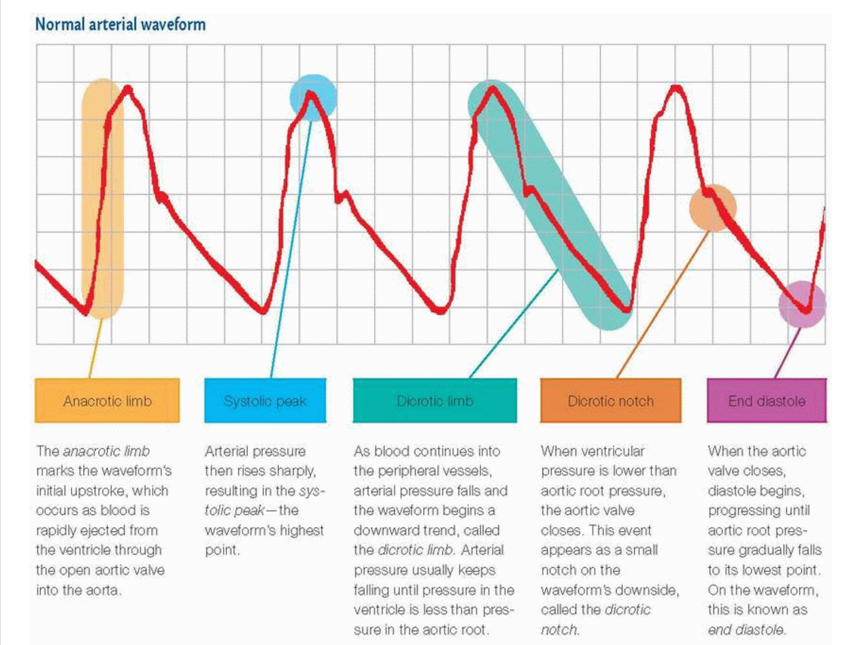
Notes:
The onset of systole first begins with the IVC phase
The IVC phase occurs milliseconds before the upstroke on the arterial pressure waveform
The aortic valve opens when the pressure in the LV exceeds the pressure in the aorta
Rapid ejection occurs and the ventricle delivers 65-75% of its stroke volume
The pressure generated is the peak systolic pressure (PSP or SYS)
After the Peak Systolic Pressure, flow velocity declines until the pressure in the ventricle falls below the pressure in the aorta, and the aortic valve closes (DN)
The blood in the aorta flows to the periphery in the runoff phase
The cycle then repeats itself
Aortic valve opening

Slide 82
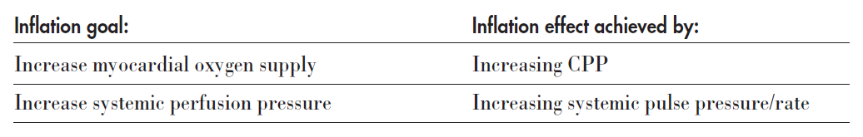
Inflation Timing

Slide 83
To accomplish goals of inflation balloon to be inflated at onset of diastole
Dicrotic notch is the landmark and inflation should occur just prior to this
Result of properly timed inflation is a pressure rise, peak diastolic pressure (PDP) or augmentation (AUG), during diastole
The PDP/AUG influences the gradient for coronary artery perfusion

Slide 84
The PDP/AUG should be higher than the PSP/SYS unless:
  1. the patient’s stroke volume is significantly higher or lower than the balloon volume
  2. balloon is positioned too low
  3. severe cases of hypovolemia
  4. balloon is too small for patient’s aorta
  5. low SVR
  6. improper timing
  7. catheter partially kinked, in sheath, not unwrapped

Slide 85
The reference point for absolute timing is the aortic root
Impossible in the critical care unit to monitor the aortic root pressure
Hence the pressure in the descending aorta via the central lumen of the balloon is measured
Results in timing waveform differences between AP monitoring sites
Inflation timing should be set to occur 40-50 milliseconds (msec) early to compensate for the delay
Notes:
Forty msec is the same as one very small block on the horizontal axis on standard ECG paper
Therefore, the inflation point should be set to occur one small block ahead of the DN on the ECG paper

Slide 86
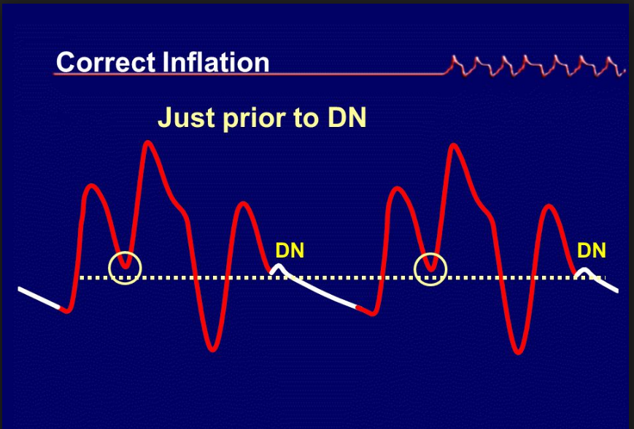

Slide 87
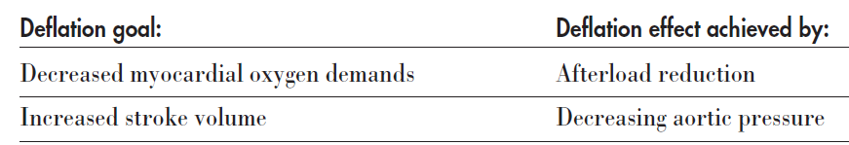
Deflation Timing

Slide 88
Deflation timing does not have the benefit of absolute landmarks
But entails assessment of pressure responses
Deflation during the IVC phase of systole causes a fall in pressure immediately preceding ventricular ejection
Represented by the balloon aortic end diastolic pressure (BAEDP) or assisted diastole (ADIA)

Slide 89
For effective afterload reduction the BAEDP/ADIA must be lower than the unassisted aortic end diastolic pressure (AEDP)
The following systole (assisted systole) benefits from the effects of afterload reduction
The left ventricle does not have to generate as high a pressure to eject stroke volume and is lower than the patient’s own PSP/SYS

Slide 90
Poor afterload reduction may be caused by:
1. Balloon not inflated to full volume causing a decrease in volume displacement
2. Compliant aortic wall which allows for only small changes in volume
3. Improper balloon placement
4. Partial obstruction of gas lumen
5.Improper timing

Slide 91
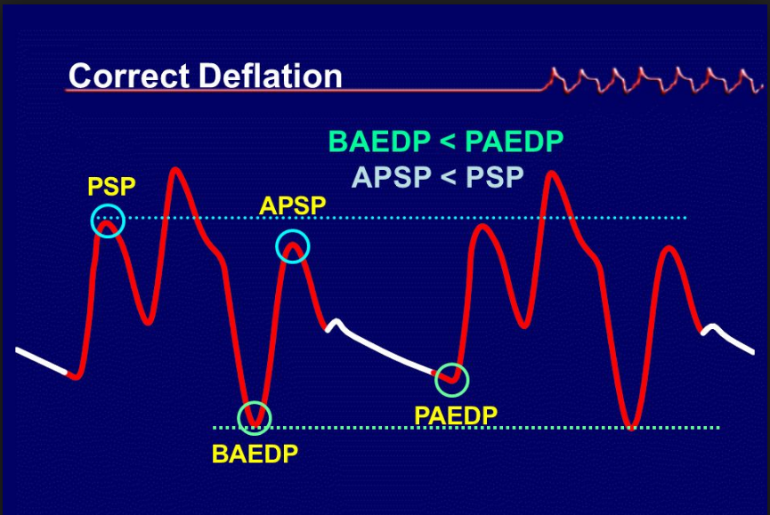
The result of properly timed balloon deflation should be
  BAEDP < AEDP (ADIA < DIA)
  Assisted PSP < PSP (ASYS < SYS)
Notes:
BAEDP/ADIA Balloon aortic end diastolic pressure or assisted diastole. Fall in end
diastolic pressure caused by balloon deflation.
Assisted Systole (ASYS) The systole following a balloon inflate/deflate cycle.
(Reduced peak systolic pressure)

Slide 92
Errors in Timing
Inflation or deflation timing errors can be in two ways:
Too early or too late
Early inflation and late deflation are potentially risky to the patient
Late inflation and early deflation are suboptimal

Slide 93
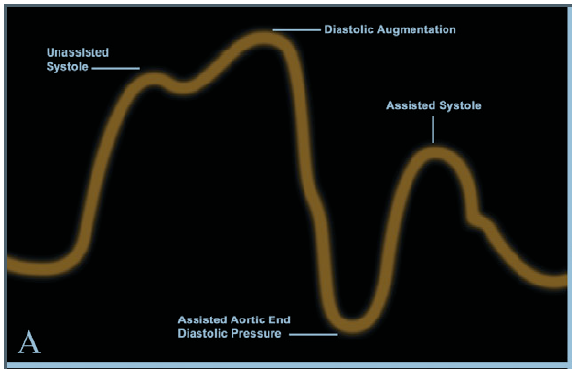
Early inflation
The IAB has inflated before the aortic valve has closed (during systole) causing premature closure of the aortic valve and reduction of SV

Slide 94
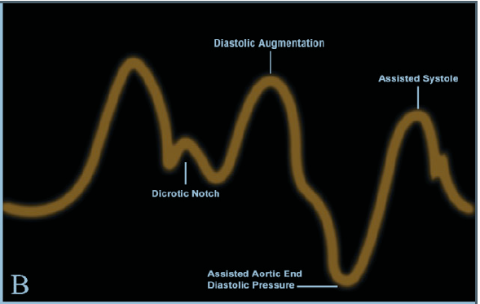
Late Inflation
Balloon is inflated after the aortic valve closes
There is not as much blood volume available for displacement resulting in a lower pressure increase
The major effect is suboptimal increase in coronary perfusion
PDP/AUG may be the same as PSP/SYS
DN is visible
Notes:
See Figure 15. During the diastolic phase there is blood flow from the aorta to the periphery
As a result the volume of blood in the aorta will decrease following aortic valve closure
Figure 15 shows late inflation. Assess the position of the DN by the assisted systole. One can
actually see the DN where it should not be seen. Inflation occurs after (late) the DN

Slide 95
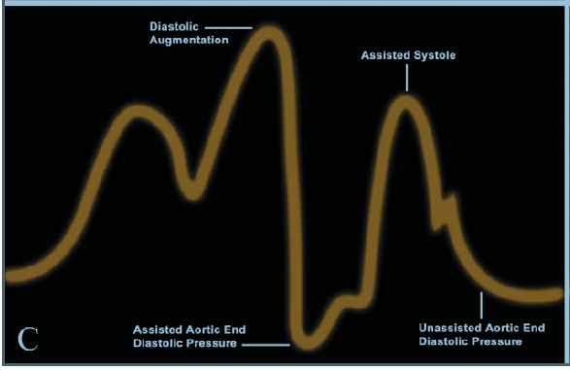
Early Deflation
Deflates before IVC
Reduction in aortic pressure occurs too soon to be of benefit
When aortic valve opens pressure in the aorta has already equilibrated back to baseline
The ventricle ejects against same pressure as it was without the balloon
Notes:
The balloon should deflate during IVC
. See Figure 16.
Figure 16 shows early deflation. In the evaluation of the pressure landmarks, there is no
reduction in the assisted systolic pressure (no afterload reduction effects). (The equilibrating aortic pressure, at heart rates less than 90, can be seen as a shelf just prior to the assisted systole.)
The net effect is that afterload reduction is not present and the workload of the heart is therefore not decreasedPSP = ASSISTED PSP (SYS = ASYS)

Slide 96
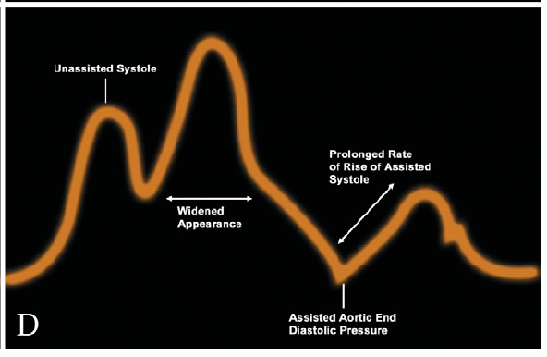
Late Deflation
Balloon is inflated (or partially ) at the beginning of ventricular ejection
LV pumps against the resistance of inflated balloon
Results in increase in workload of the ventricle and impedance of SV
Hallmark of this timing error is BAEDP/ADIA higher than AEDP/DIA
Notes:
Figure 17 shows late deflation. In the evaluation of the pressure landmarks there is an increase in the BAEDP/ADIA.

Slide 97
Arrhythmia Timing on the IABP
In irregular rhythm conventional timing algorithms may have difficulty maintaining consistent appropriate inflation/deflation
"Real Timing" (true R wave deflation) or "Arrhythmia Timing" modes may result in more efficent deflation timing
Inflation timing is set as usual in these modes
Deflation of the balloon is automatic once the next systolic cycle is identified
The major benefit is having the full period of diastole augmented to enhance perfusion and minimizing the potential negative effects of early and/or late deflation

Slide 98
Balloon Pressure Waveform
The Balloon Pressure Waveform represents the helium movement between the console and the IAB catheter
It is displayed as a calibrated, continuous waveform which allows objective assessment of counterpulsation

Slide 99
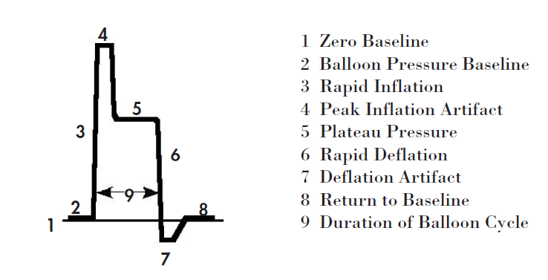
BPW Height
Reflects the pressure in the aorta
Plateau pressure on the BPW should be within ±25mmHg of the AUG pressure
BPW Width
Reflects approximately the duration in which the balloon is inflated

Slide 100
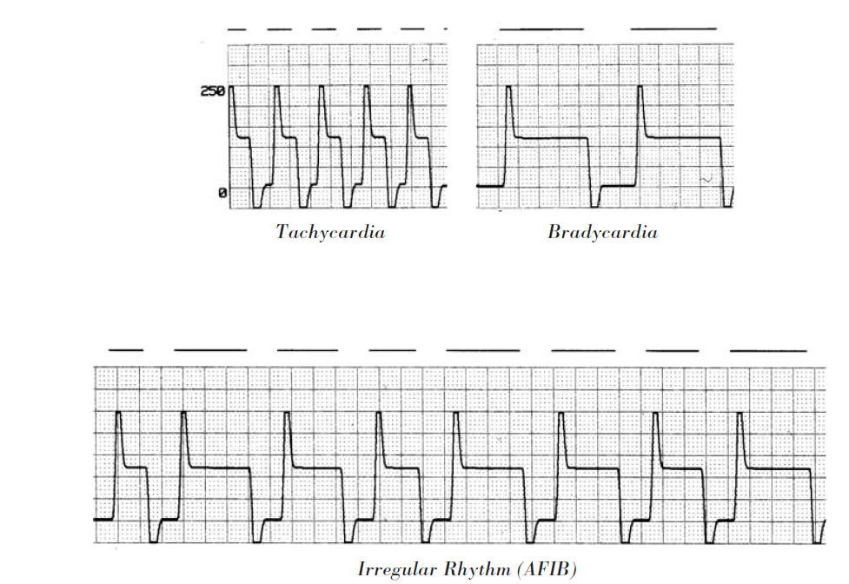

Slide 101
MAINTENANCE CARE
Ankle flexion and extension one to two hourly
Use pressure relieving mattress
Change ECG electrodes daily
Change occlusive dressing daily
Secure balloon catheter at several points along the limb

Slide 102
OBSERVATIONS
Observe hourly at catheter insertion site
  For signs of bleeding
  Signs of infection
  Signs of blood in sheath
If blood or brown dust is observed within the lumen immediately place the IABP on 'Standby'
The catheter will have to be removed immediately.

Slide 103
OBSERVATIONS
Check hourly for left radial pulse
Put SaO2 probe on left hand
Assess the limb distal to the insertion
One hourly Observe and record peripheral pulses, capillary refill, skin, temperature
Observe the waveform to ascertain that the timing is correct

Slide 104
Weaning from the Intra-Aortic Balloon Pump
The time and speed are dictated by the patient’s hemodynamic status
Accomplished by decreasing the frequency and/or volume of balloon Inflation
Decreasing the frequency of assistance from one balloon inflation per cardiac cycle to 1:2, 1:3, 1:4, and 1:8
Also accomplished by decreasing the volume delivered to balloon
Notes:
There are two methods of weaning which may be used independently or in conjunction with one
Those patients requiring the IABP because of profound cardiogenic shock will probably wean more slowly than those needing balloon assistance for instability due to low cardiac output syndrome following cardiac surgery
Do not reduce the volume delivered to the balloon less than 2/3 the capacity of the balloon, i.e. a 40cc balloon should not have the volume reduced to less than 28cc

Slide 105
IABP support may be discontinued if…..
1. Signs of hypoperfusion due to low cardiac output syndrome are absent
2. The urine output can be maintained above 30ml per hour
3. The need for positive inotropic agents is minimal
4. The heart rate is less than 100 beats per minute
5. Ventricular ectopic beats are fewer than 6 per minute, not coupled and unifocal
6. The cardiac index remains equal to or greater than 2 l/min/m2
7. The index of LVEDP (PCWP, PADP) does not increase to greater than 20%
above pre-weaning level
8. Absence of angina

Slide 106
IABP REMOVAL
Discontinue heparin six hours prior
Check platelets and coagulation factors
Deflate the balloon
Withdraw the IAB catheter through the introducer sheath until resistance is met
NEVER attempt to withdraw the balloon membrane through the introducer sheath
Remove the IAB catheter and the introducer sheath as a unit
Apply constant pressure to the insertion site for a minimum of 30 minutes
Check distal pulses frequently

Slide 107
CONCLUSION
IABP is the most commonly employed coronary and systemic circulation assist device
The overall aim of this therapy is to improve myocardial function by better matching of myocardial oxygen supply and demand
Proper use includes setting an appropriate augmentation frequency ratio and trigger and ensuring correct timing of balloon inflation and deflation
Major complications occur in fewer than 3%
IABP will continue to have a lead role in providing temporary mechanical cardiovascular support in near future
Notes:
These include cardiogenic shock secondary to AMI refractory to medical therapy, some mechanical complications of AMI, refractory ventricular arrhythmias, refractory unstable angina and decompensated systolic heart failure(as a bridge to definitive treatment)
Controversy has arisen as to the utility of IABPs, but registry data, randomized data, and anecdotal data can be quoted to support their benefit

Slide 108

Thank you

